Slide 1
How to Speak
Business Case
Mike Lynch
University of Technology Sydney
eResearch Support Group
Notes:
Context: our unit (eResearch support) has been brought into the same project funding process as the rest of the University’s IT
My presentation is a quick case study of how we developed a business case for our first project in the new system
The new rebrand is an example of the corporate side of the university emulating the look and feel of dataviz
The encounter between these cultures is awkward and sometimes hostile
I’m optimistic: describing your project in the language of corporate IT can help you and your users

Slide 2


Us v Them:
Scholarship v Corporate IT
Uts eresearch support group
Heading 3 (26pt)
Notes:
US:
Supporting the functions which only our institutions do: research, scholarship, long-term preservation
Scholarly ideals: knowledge for knowledge's sake, research which doesn't necessarily have a direct monetary value
Specialisation, dedicated systems, fragility, "just build it”
Can be hostile to the idea of cost/benefit analysis at all: antithetical to our values
THEM
Supporting functions common to all institutions (email, storage, backup etc)
Can be unaware of the details, like what an academic supervisor is for a PhD student.
Economies of scale, standards, robustness, moving stuff to the cloud
Cost /benefit analysis is fundamental to decision-making, or should be

Slide 3

Us v Them:
What everyone else sees
Uts eresearch support group
  Core nerd values:
  Standards are good
  Explicit is better than implicit
  Planning and estimating are good, even
  if impossible
Notes:
To everyone else, we’re all nerds
What have we got in common:
Standards are good
Explicit is better than implicit
Planning and estimating is good (even if it’s impossible)
We still need to allocate scarce resources between goals, even if we’re a university
Universities: a history of doing corporate IT as if it were research IT (we had it first) – ramshackle, badly planned, brittle
Continuation of this process into research / scholarship IT

Slide 4

Our project:
Provisioner
Uts eresearch support group
Provisioner – a research app service catalogue
OMERO – microscopy
GitLab – code-centric research
Stash – upgraded research data repository
Linked open data, rainbows and unicorns
Notes:
Our project – a middleware framework which will let us move research workspaces between dedicated research apps OMERO and GitLab, generic infrastructure like storage on the Isilon, and our research data catalogue / repository
First draft of business case had lots of good ideas:
Data re-use
Automated metadata capture
Open data + scholarship
Rainbows and unicorns
Our project manager told us: where are the tangible benefits

Slide 5

Tangible benefits:
Round one
Uts eresearch support group
Scholarship on research impact and the value of open data
High-level
Emphasis on commercialisation and funding
Large institutions and particular disciplines (medicine)
Long timelines
From a PM’s perspective, these are still unicorns
Notes:
there's a body of scholarship on the impact of research, the value of open data
it's high-level stuff, examples tend to be focused on large, well-financed instutitions in fields which spin off $$$ (like medical research)
good for governments and heads of universities, but still intangible from a PM perspective
PM: show me how much money this will save us over the next five years

Slide 6
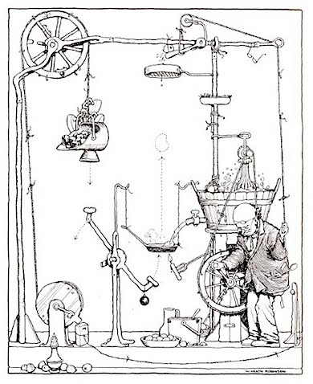
Tangible benefits:
Round two
Uts eresearch support group
How is the project going to help its users?
Researchers: automated data description
Facility staff: reduce admin work
Data librarians: higher quality metadata
Tech support: easier management of storage
Developers: good design means less effort
None of these translate into very much $$$
Notes:
How will our project save its immediate users time and effort?
Researchers: dedicated apps, automate data description
Facility staff: automated administration
Librarians: automate some data description
eResearch support: much easier to manage storage if data is well-described
Developers: good design means reusable code, no point-to-point integration
Best estimates of the savings from these: still not a lot of money, and saving developer time shouldn't be counted (it's saving from money you won't spend if the project doesn't go ahead)

Slide 7
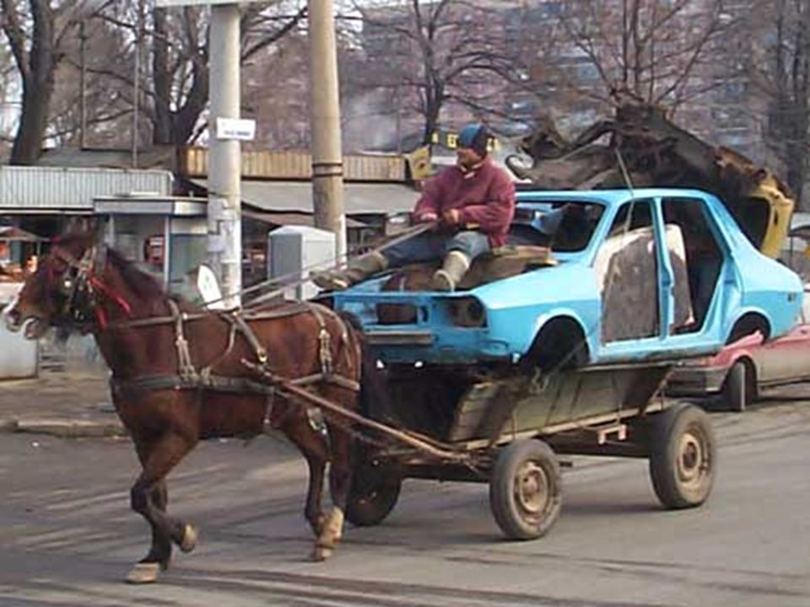
The value of data reuse
Uts eresearch support group
Cost of generating data: researcher salaries
Researcher effort for typical dataset
Average researcher pay rate
Conservative guess of % of managed data will be
re-used
Puts a dollar value on data re-use which is comparatively
unicorn-free
Notes:
Data costs $$ to generate: facilities, expendables, equipment depreciation etc
Biggest single input is researcher salaries
We can estimate researcher effort for a typical dataset (varies wildly between disciplines, no 1:1 mapping)
We know how much we're paying our researchers
We can conservatively guess the likelihood of a well-managed dataset being reused is
this gives us a dollar value on data reuse which is relativelty unicorn-free

Slide 8

Conclusion
Uts eresearch support group
Business cases are useful
Focus your projects on immediate researcher
benefits
Mainstream what can be mainstreamed
Ideals like linked open data, open architectures can
help move research infrastructure from bespoke
to mainstream
Notes:
These estimates are rubbery, but all project estimates are a bit rubbery
Short term, based on real costs
Can be measured – we will be able to count dataset re-use
Focus on achieving researcher benefits
Mainstream those IT functions which can be mainstreamed: resilience, robustness, economies of scale
Without abandoning the big picture (linked open data, scholarship)

Slide 9
Thank you
Mike Lynch @bombinans

