Slide 1

Building rich data discovery interfaces from RO-Crate collections with Oni
Mike Lynch
University of Technology Sydney
Notes:
Hi, I’m Mike Lynch from the University of Technology Sydney, and this presentation is about Oni, which is a tool for research data discovery which we've been working on at UTS for a few years.

Slide 2
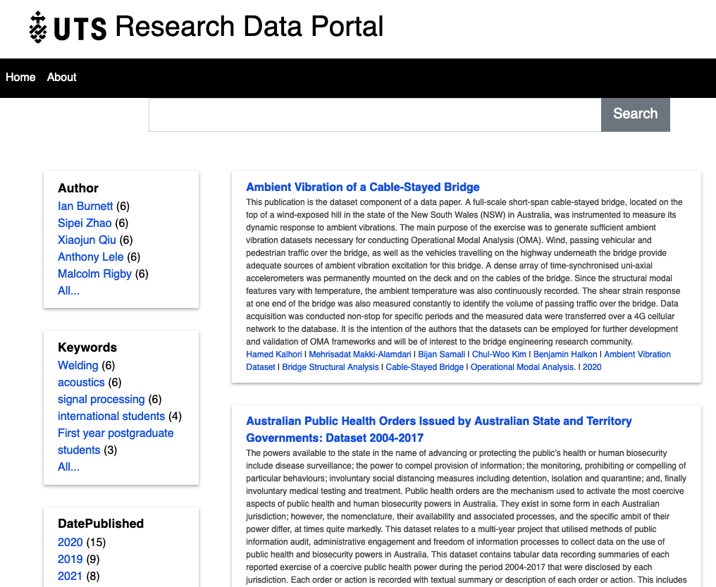
Oni
Search and discovery tool based on RO-Crates and Solr
Datasets described with RO-Crates
Faceted search with Solr
Spin-off from our ReDBox RDMP tool
Data repositories: many RO-Crates with downloadable payloads
Data collections: one big RO-Crate, with or without a payload
Title
Musaperchil
ilis sit audae
eostrum laut
untis accus
Title
Musaperchil ilis sit audae eostrum laut untis accus magnima vendel maio inulparum voles sit, se porro quam endenti urisquatur
Title
Musaperchil ilis sit audae eostrum laut untis accus magnima vendel maio inulparum voles sit, se porro quam endenti urisquatur
Title
Musaperchil
ilis sit audae
eostrum laut
untis accus
Notes:
The idea behind Oni is that if you have datasets on disk described with RO-Crates, we can use an off-the-shelf, established search engine - Solr - to provide a web-based data discovery service which would suit data from many disciplines at different scales.
It's a spin-off from our research data management planning tool, ReDBox, which has a simple data publications portal. Datasets are described with RO-Crates - which is a standard based on JSON and Schema.org for describing research data.
Oni inspects all of the RO-Crates, picks up the machine-readable metadata and uses it to build an index in Solr.
The front-end for this is a very simple web app which provides a faceted search interface, and serves up the human-readable metadata as a landing page for each dataset.
Today I'm going to describe another use of Oni - allowing exploration of a single data collection.

Slide 3
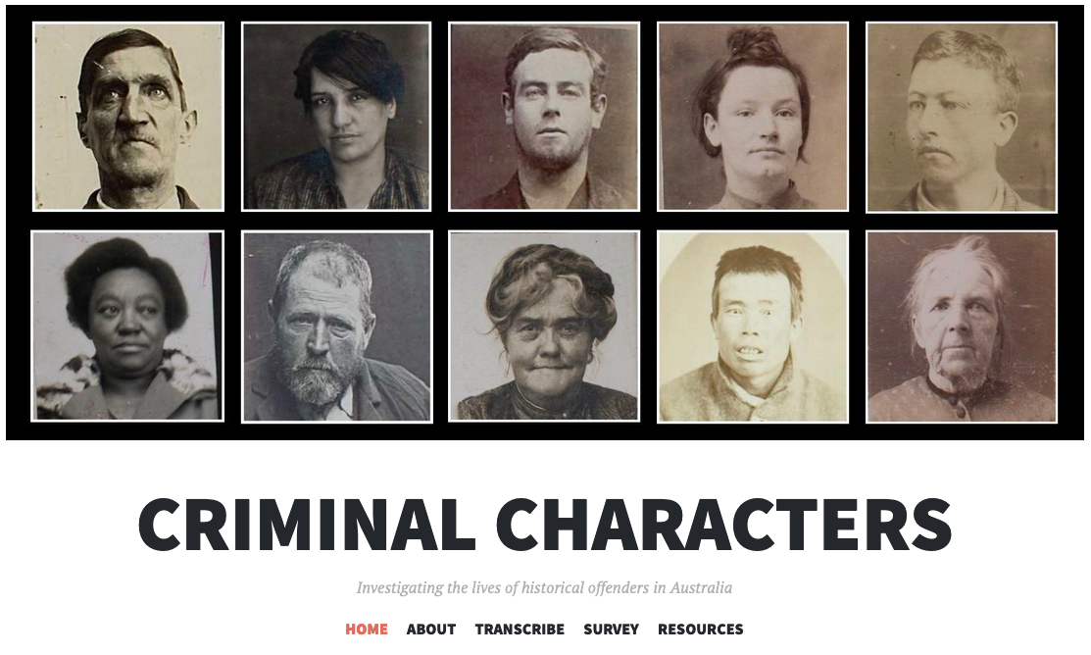
The Collection
Criminal Characters – Dr Alana Piper
Handwritten historical convictions
Transcribed on Zooniverse
Structured historical dataset
  Person
  Sentence
  Place (Court)
One Person may have many Sentences, at different Places
Title
Musaperchil
ilis sit audae
eostrum laut
untis accus
Title
Musaperchil ilis sit audae eostrum laut untis accus magnima vendel maio inulparum voles sit, se porro quam endenti urisquatur
Title
Musaperchil ilis sit audae eostrum laut untis accus magnima vendel maio inulparum voles sit, se porro quam endenti urisquatur
Title
Musaperchil
ilis sit audae
eostrum laut
untis accus
Notes:
The dataset comes from Dr Alana Piper's Criminal Characters project, which is a really interesting example of structured humanities data.
The data we've been working with started out as handwritten court records for female convicts in Victoria in the late nineteenth and early twentieth centuries. These have been transcribed using the crowdsourcing platform Zooniverse, turning images of the court records into structured text records about the subjects.
This gives us a structured dataset. Persons can have one or more sentences. A sentence includes the crime of which the person was convicted, the sentence they recieved, the date of the sentence and the court which handed it down.
A court has a name, like Melbourne General Sessions, and a geolocation - a latitude / longitude pair.

Slide 4
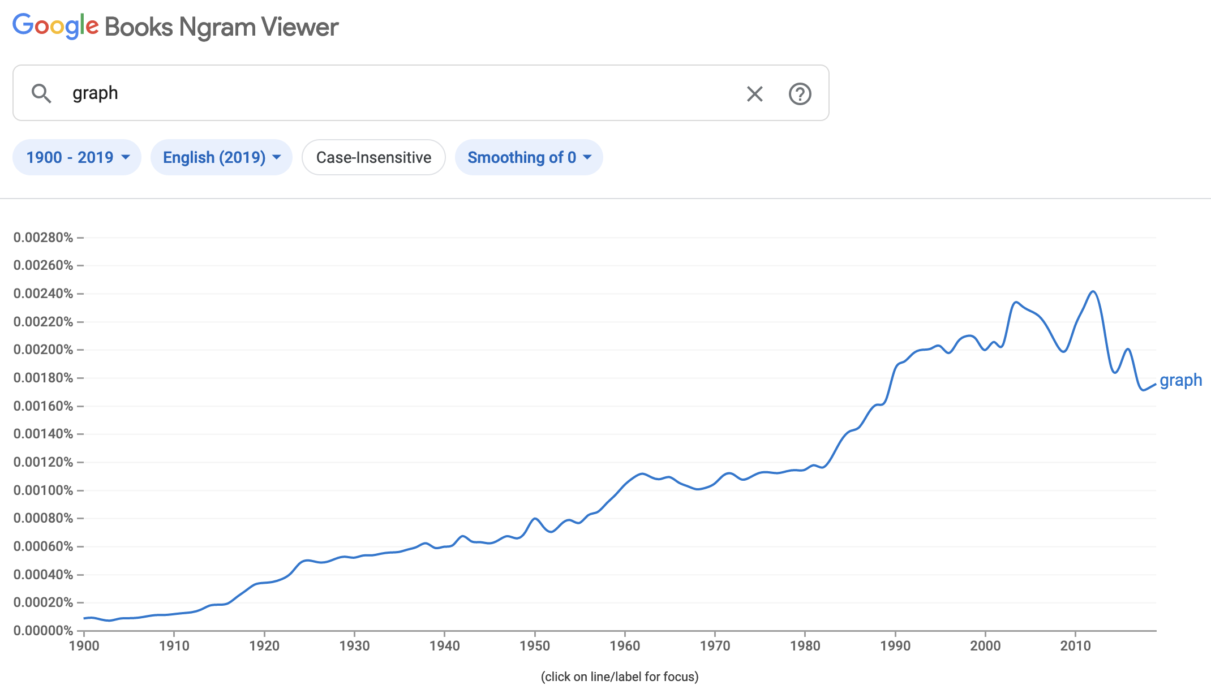
Graphs
Not that kind of graph
What do I mean when I talk about the ‘graph’?
A ‘graph’ in this sense is a collection of nodes, with links connecting them
RO-Crate stores its metadata as a JSON-LD graph
A Person has a property ‘birthPlace’ linking it to a Place
Notes:
I'm going to have to talk about graphs, so I need to be clear what I mean by that. It's unfortunate, because I think that the word "graph" in everyday language means one of these.
IT people love borrowing terminology from mathematicians, even when - or especially because - it's confusing to lay people.

Slide 5
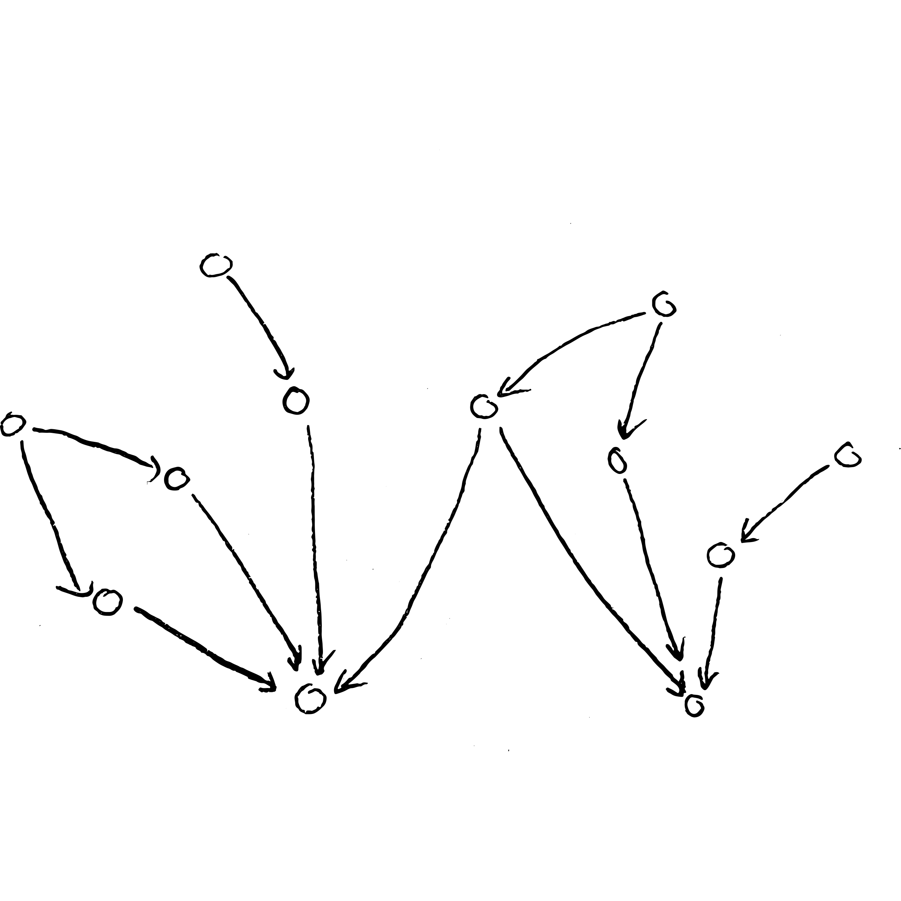
Graphs
This kind of graph
What do I mean when I talk about the ‘graph’?
A ‘graph’ in this sense is a collection of nodes, with links connecting them
RO-Crate stores its metadata as a JSON-LD graph
A Person has a property ‘birthPlace’ linking it to a Place
Notes:
A 'graph' in this sense is a collection of nodes, with links between them: what we might call a 'network'.
The machine-readable part of an RO-Crate is stored in a format called JSON-LD - a standard for describing linked data in JSON - and the interesting part of a JSON-LD document is called the graph.
The graph is a set of items, such as Person, Place, and so on, which are connected by properties.
So, for example, a Person will have a property 'birthPlace' which links it to another item, which is a Place.

Slide 6
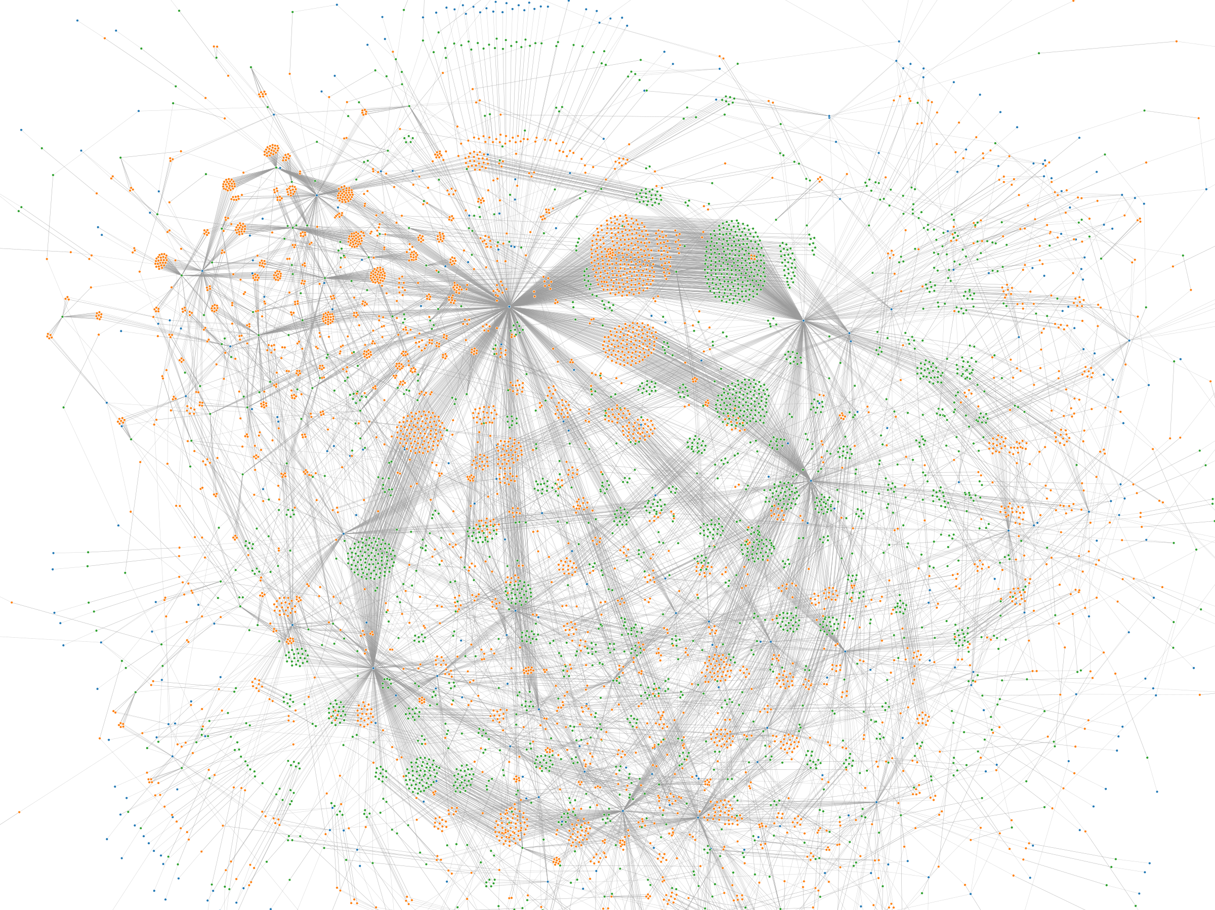
JSON-LD Graphs
The whole RO-Crate
The graph: a network of nodes connected by links
Used Observable
Good as a slide or desktop background
The hubs represent important courts with many convictions
What’s the best way to allow exploration of this data on a more useful scale?
Notes:
The single RO-Crate representing this part of Criminal Characters has about 7000 nodes with 13000 links joining them.
As an experiment, I used Observable to generate a visualisation of it as a force-directed graph. Observable is very cool: it's like a slicker version of Python notebooks, but for the d3 framework, and I really recommend it as a way to learn d3 and build web-based visualisations
This is the sort of high-level view of a big networked dataset which looks really cool on a slide or as a desktop background.
There's some structure visible here - the big hubs are busy courts which have many convictions.
It would be technically possible to build a search and filter into the Observable visualisation, but at this scale it woudn't really be usable.
We want to think of ways to allow exploration of this data at a more useful scale.

Slide 7
One way to do it
Person
ID
Surname
Givenname
DOB
Sentence
ID
Person_ID
Court_ID
Offence
Sentence
Date
Relational database
Tables for each data entity
Relations between them
Search: a query which returns the Person, joined to other tables to get context
OK for simple queries
Complex relations will need well-crafted SQL for performance
Not flexible if we want to change what we’re looking for
SQL
Place
ID
Name
Lat
Long
Notes:
One way to do this would be to find someone with the technical skills to build a web app around a relational database. You have tables for each of the data entities you're interested in, and relations between them.
You then build a search interface which runs an SQL query. But returning just a list of People which match your query isn't very interesting.
So you have to join your query to other tables like Sentence and Place to provide some context.
For simple queries, this is ok, but for even moderately complex relations, you need to put some thought into your SQL for performance. Or take a less elegant approach, and run a couple of SQL queries to pull in the contextual information for your primary object.
But now that you've crafted a relational web app, you've lost some flexibility. If you want to change what sort of context you want to view, you need to refactor your SQL queries, change how the front end works, and so on.

Slide 8
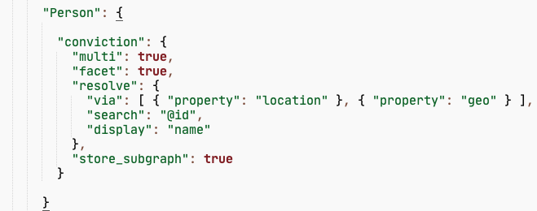
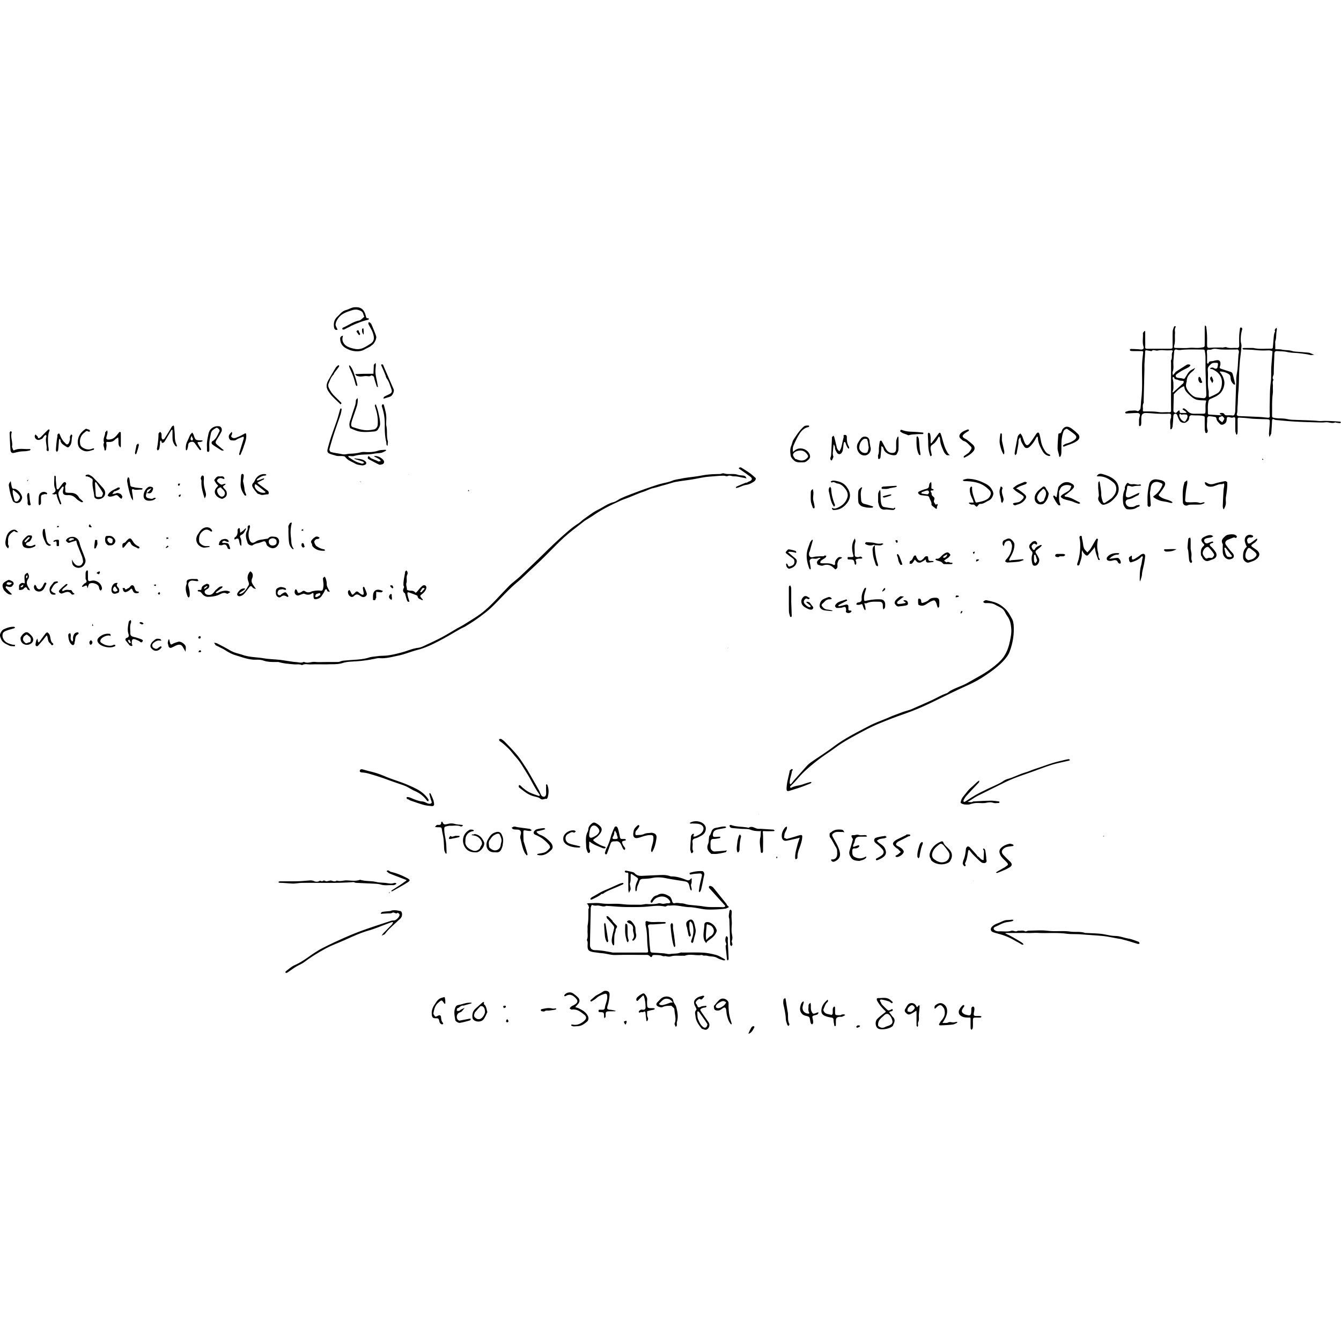
The Oni way to do it
Index an item’s context
Oni’s indexer transforms JSON-LD items to Solr documents, based on config
This is the config for a Person
Fields from the item itself (name)
Resolve lookups into another item by id
Resolve lookups via intermediate items
Capture everything along the way
The subgraph is a Person’s local context
Redundant, but it doesn’t matter
Notes:
The Oni way to do it is based on the idea that when we index an item - a Person, say - we should index all of the context as well.
The first thing I did when I'd indexed this dataset was to search for my surname, and found three or four Lynches: I've picked on Mary as an example of how the indexer works.
This is the config for transforming a Person into a Solr document we can index. The simplest mappings are from the Person's own fields, like name and religion, into the Solr document. These are all mapped automatically.
The config can also pull in values from items which are linked to this one. These can be either by following a single link, or by resolving links across multiple items.
To find out what Mary was convicted of, and where, we're telling the indexer to follow the link called ‘conviction’, to an item – this should be a Sentence - then follow the location property of the Sentence, to get to a Place representing the court, then follow the ‘geo’ property to get the actual latitude and longitude.
My colleague Peter Sefton had this idea: while we're traversing Mary Lynch's links, we can save all those nodes and store the resulting subgraph in the index. This is Mary's local neighbourhood in the big graph - her context.
The way we're indexing the dataset is pretty redundant. We saw on the last slide that some of the courts in this data have hundreds of convictions. Each of those courts is going to get included in the index of every person who was convicted there, so there are a lot of copies.
But that's OK - we're basically trading off space against time. We're saying, it's OK if the index is bigger than it might be, but it's worth it, because when we get search results back, they will come back fast and have all the context which we think is relevant.

Slide 9
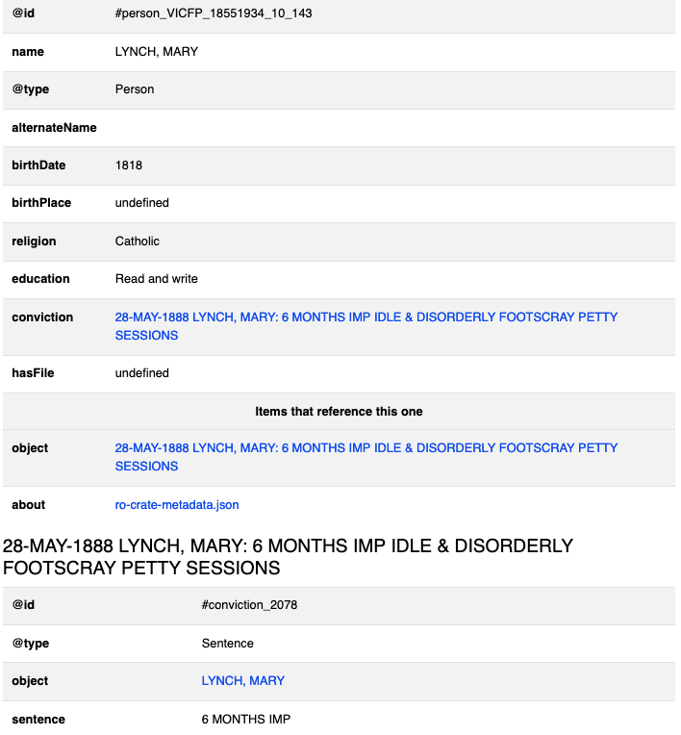
The Oni way to do it
Render the subgraph
But: what’s the browser supposed to do with a chunk of JSON-LD?
The RO-Crate library already has code to render a JSON-LD graph as HTML
The frontend uses the same code to render a subgraph
We can change what the context looks like by changing the index – there’s no extra frontend config required
Notes:
So having build this index full of JSON subgraphs, what do we expect the front-end to be able to do with it?
We already have code for turning JSON-LD into HTML: it's part of the standard set of RO-Crate libraries which we've been building.
And because it's in JavaScript, it's relatively easy to call from the portal app.
It's not especially pretty (but there's room to style it)
This approach means that if we change how the dataset is represented in the underlying RO-Crate, or decide that we want to index it differently, we don't have to do modifications to the front-end to keep it in sync. It will just render whatever we put in the subgraph at indexing time.

Slide 10
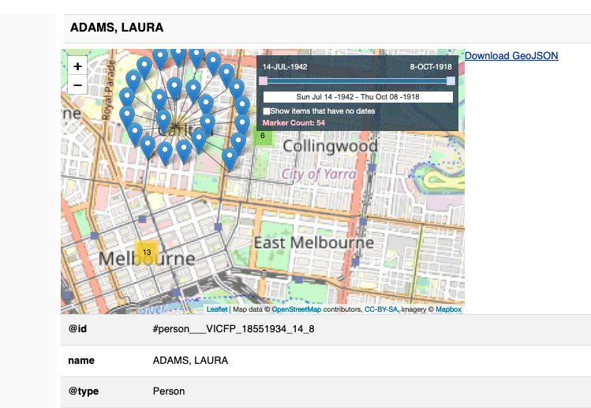
Geolocations
The front-end already lets us configure fancier viewers for certain data types
A simpler approach to geolocations
For a subgraph, filter out everything with a lat, long, and render those in a Leaflet map widget
The same approach gives us geolocations on a bunch of search results, and on individual documents
Notes:
One of the requirements we had for this dataset was to be able to render the time and place of convictions - we did this with a map widget based on Leaflet, which had been extended to add a time slider.
The front-end has the ability to configure specialised viewers for certain parts of the index document.
But a simpler approach is to tell the frontend: this dataset has a subgraph, and when you're processing that, look for geolocations and put them on the map widget.
Again, this avoids the need for any more detailed configuration which would need to be kept in sync with the backend.
And it also means that we can present geolocations for both an individual record, and for a set of search results, using the same code.

Slide 11
Thank you
Links
RO-Crate: https://www.researchobject.org/ro-crate/
Oni: https://github.com/UTS-eResearch/oni-express
Arkisto: https://arkisto-platform.github.io/
Criminal Characters: https://criminalcharacters.com/
Observable: https://observablehq.com/
Acknowledgements
Dr Alana Piper
Dr Peter Sefton
Moises Sacal Bonequi
Notes:
I'd like to thank Alana for the data, and Peter Sefton and Moises Sacal Bonequi who are the other main developers behind Oni. Thanks for listening.

