Slide 1
Front End Loader
Modern web technologies for interactive digital humanities collections
Michael Lynch
Data Science Group Lead
Sydney Informatics Hub
University of Sydney

Slide 2
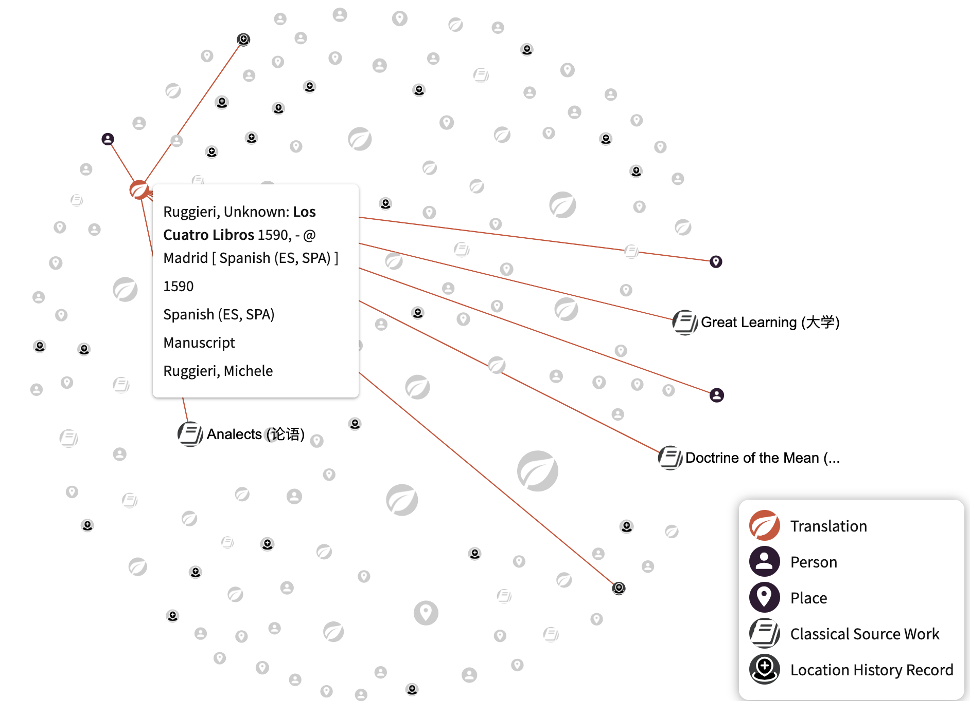
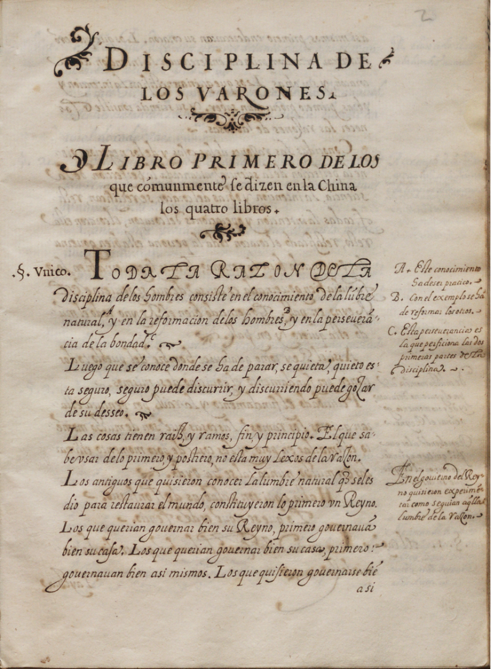
Transforming the East
https://textus-sinici.org/
A/Prof Francesco Borghesi, Dr Danial Canaris, Prof Yixu Lu
Great Learning (大学)
Doctrine of the Mean (中庸)
Analects (论语)
Los Cuatro Libros
Year: 1590 Translator: Ruggieri, Michele Language: Spanish
Place of translation: Madrid
Locations of MS: National Taiwan University Library, Real Biblioteca del Monasterio de San Lorenzo el Escorial
The University of Sydney

Slide 3
A digital humanities web stack

Slide 4
Web programming: a short history

Slide 5
Web programming: a short history

Slide 6
RO-Crate

Slide 7
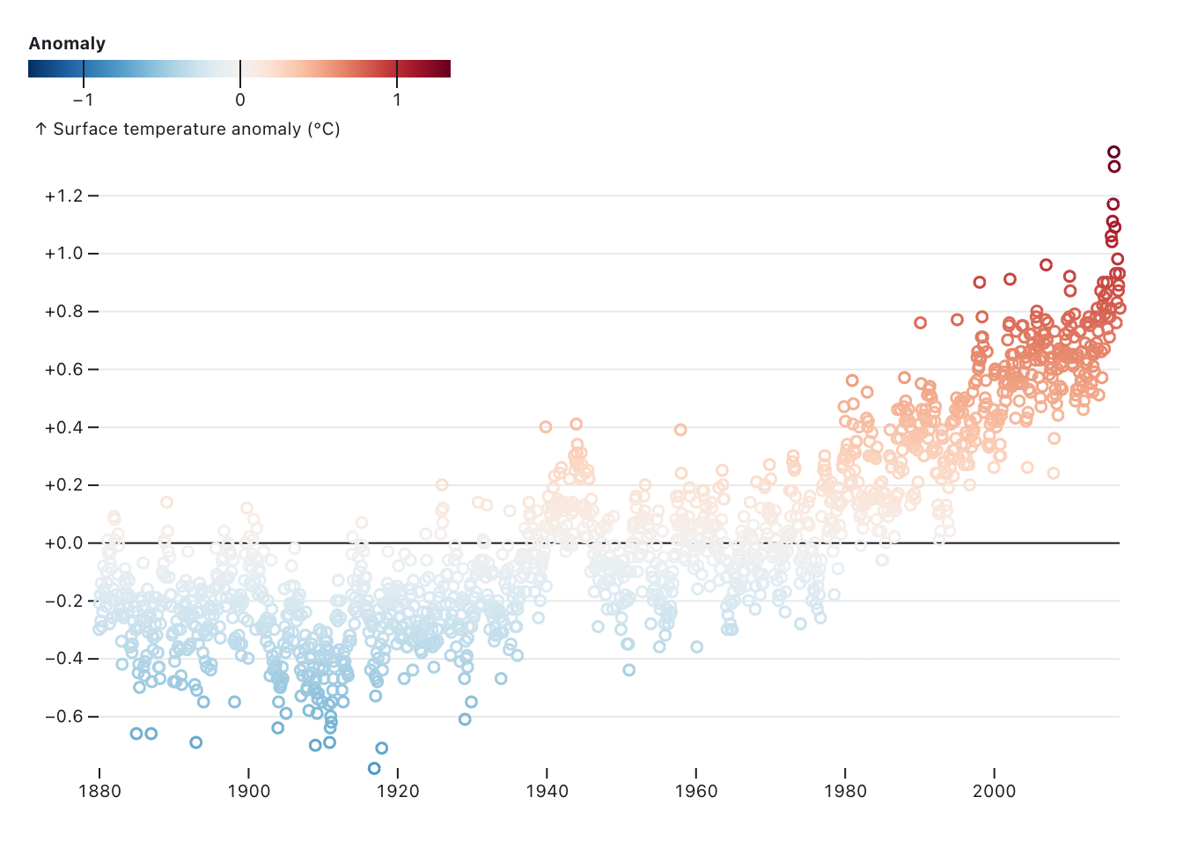
Observable
https://observablehq.com/

Slide 8
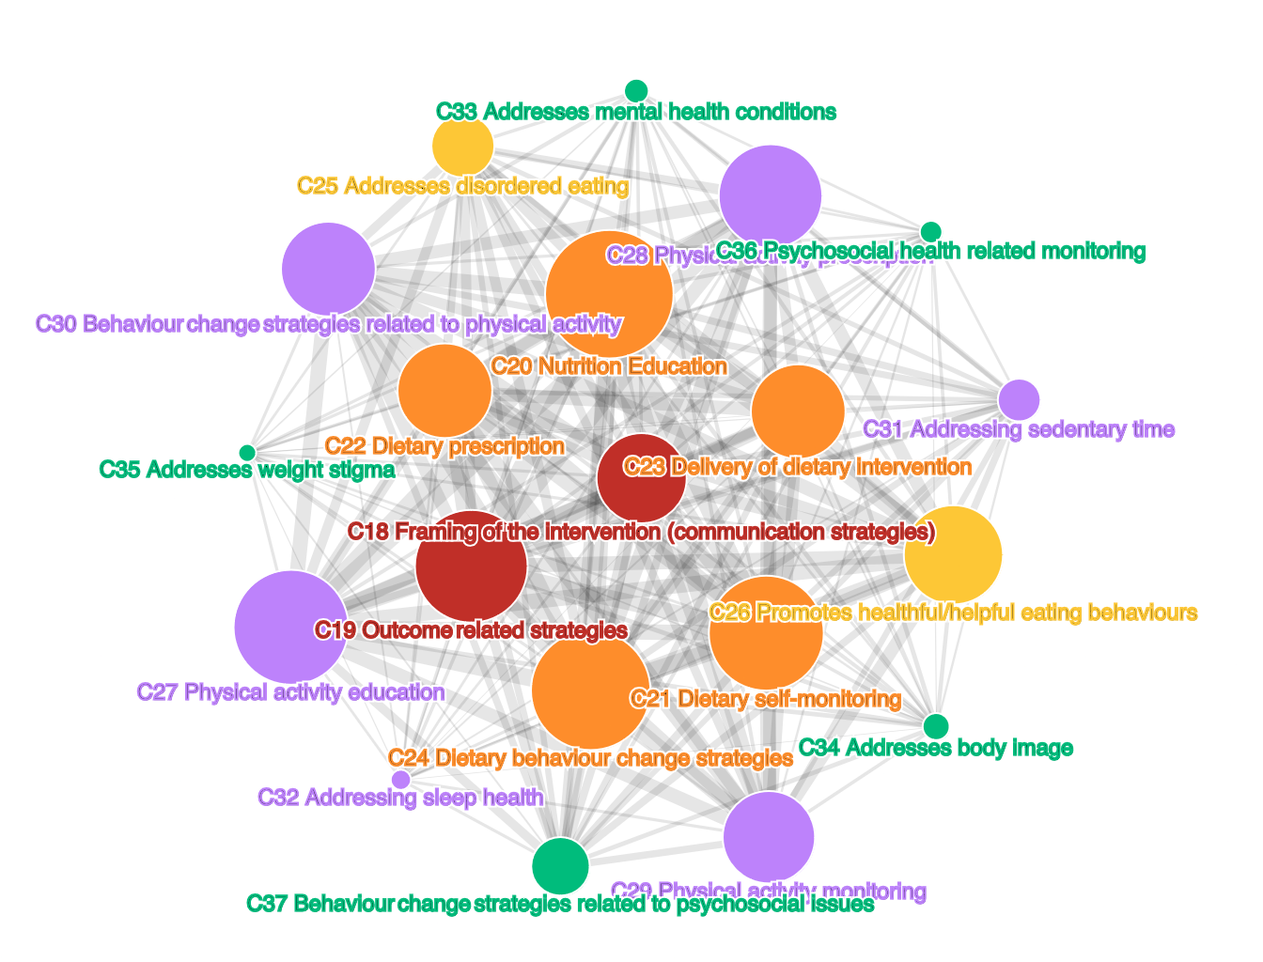
Observable: reactive code for data exploration
Notes:
reactive coding style notes

Slide 9
Web programming: a short history

Slide 10
Building a "static" website

Slide 11
Front End Loader: v0.1.0

Slide 12
Front End Loader : v0.1.0

Slide 13
WebAssembly

Slide 14
RO-Crate to SQLite

Slide 15
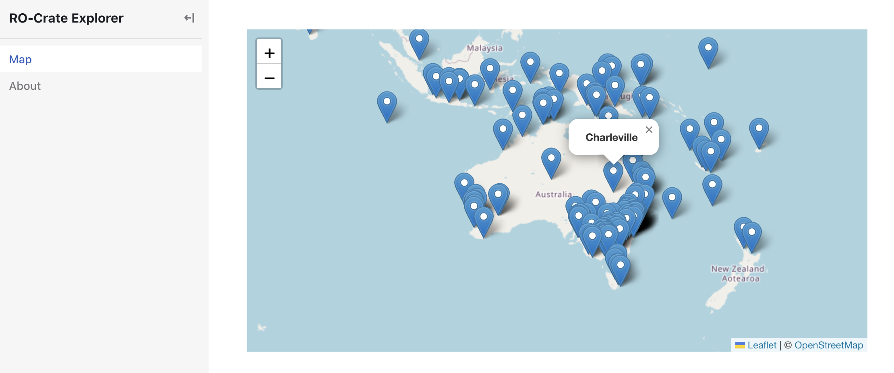
Front End Loader v 0.2.0

Slide 16
Use cases and caveats

Slide 17
End slide with university and social links
Sydney Informatics Hub
Mike Lynch
first.last@sydney.edu.au
sydney.edu.au/research/facilities/sydney-informatics-hub.html

